Slide 1


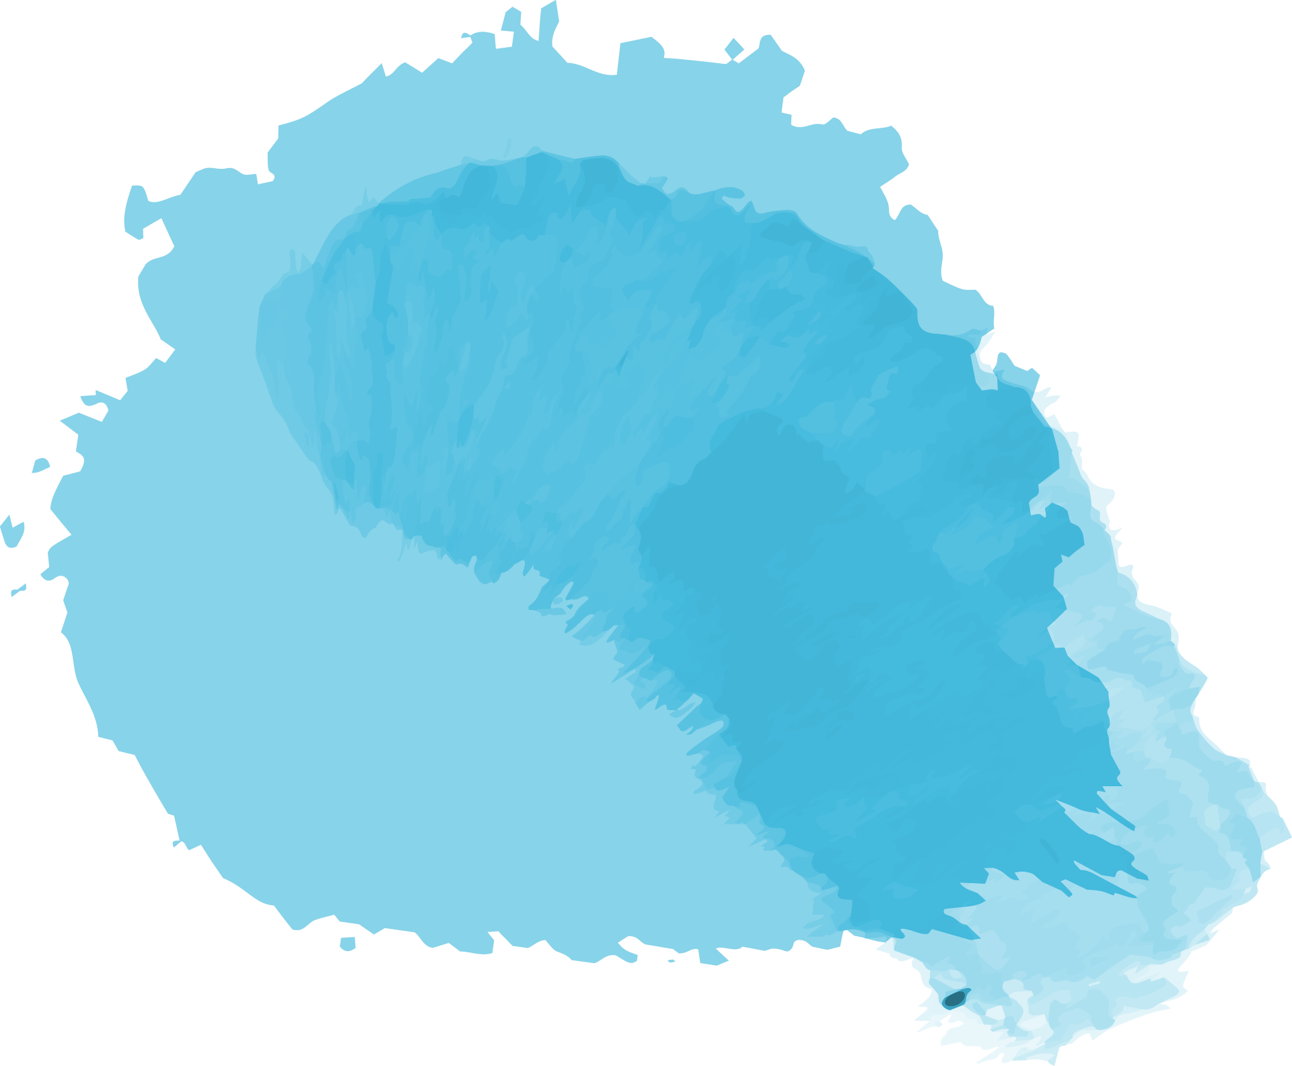


Smart Tank Water Level Monitoring System using IoT
Software Group Project (SEM 7)
18DCS070 – Jay Patel
18DCS092 – Jehan Patwa

Slide 2


Table of Contents
01
02
Introduction
03
Domain used
Hardware and software used
04
05
06
Screenshots
Limitations
Flow chart
Learning Outcome
07
08
09
FutureScope
Reference

Slide 3
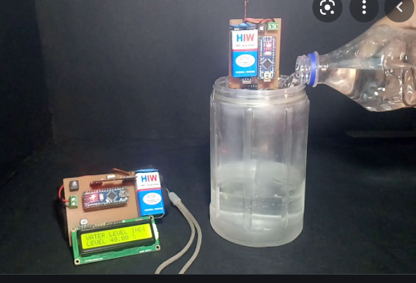
Introduction
This Project detects the current level of water inside the water tank.
With the help of our system, user can set desired water level for the tank and automatically our system will stop the flow of water after certain level is reached.
The sensor can measure the water level upto 4m.

Slide 4
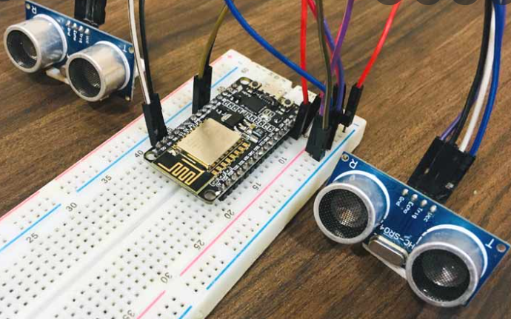
Domain Used
IoT(Internet of Things)
Here IoT devices are used to fetch the data and to send this data to cloud.
ASP.net and C#
This data are shown on website made with c# and ASP.net.

Slide 5
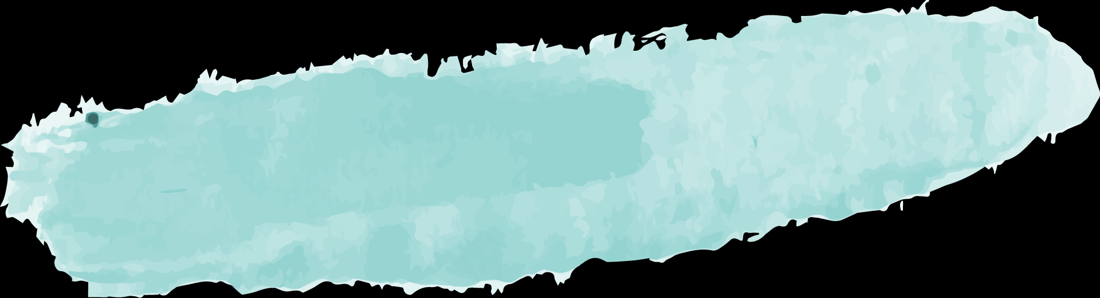

Hardwares and Softwares
Hardware
Software
Iot devices.
Ultrasonic Sensor
Breadboard
Jumper wire
Node MCU
Water tank
Ardiuno
VS code
Thinkspeakcloud

Slide 6
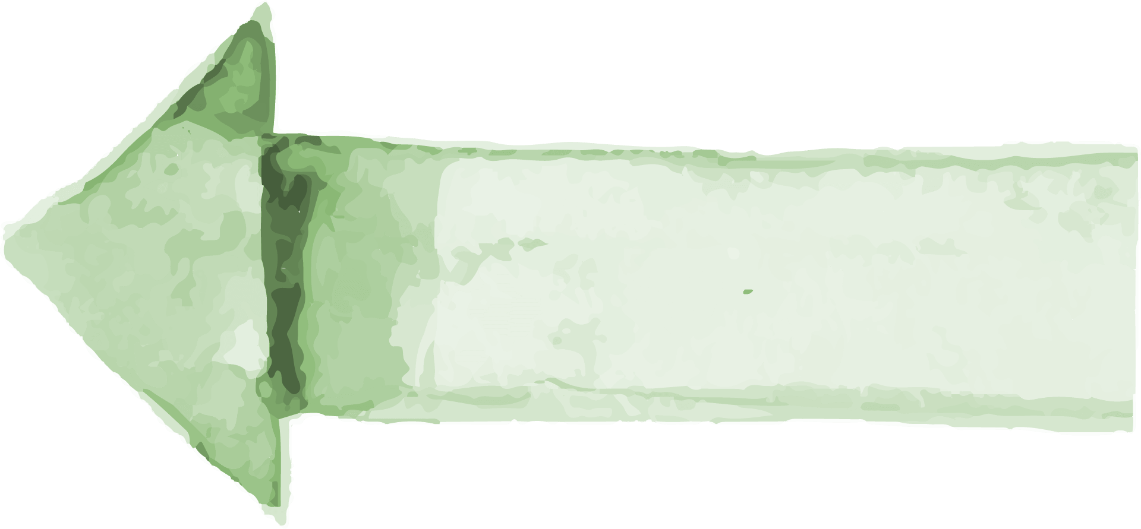
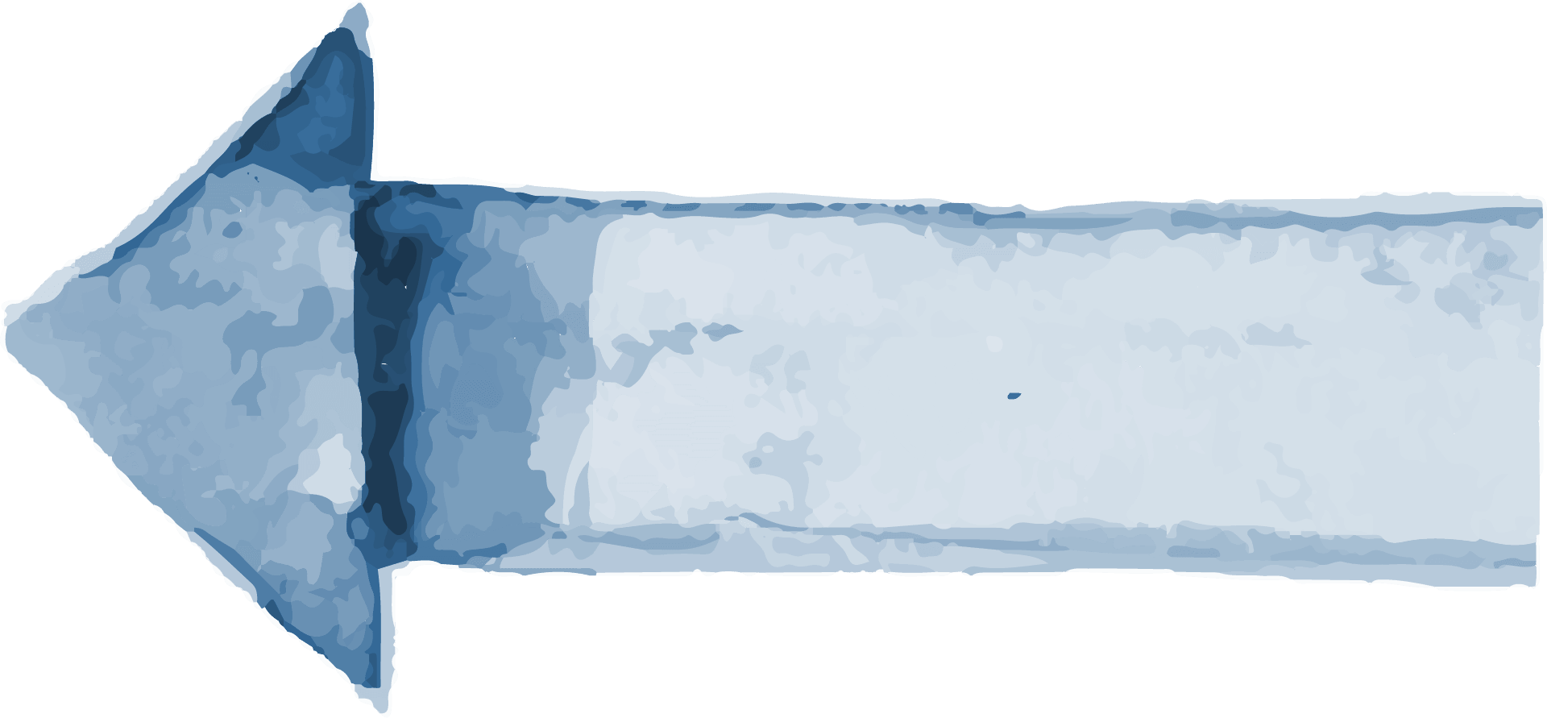

Flowchart
02
03
01
Interfacing IoT Devices
Connection with cloud
Transfer of data
Integrating the IoT devices.
Connection of NodeMCU with cloud.
Transfer of data from NodeMCU to cloud.
Display
User account
Connection with website
Display of the data recieved from the cloud.
Creating the account for the user.
Connection and transfer of data from cloud to website.
06
05
04

Slide 7
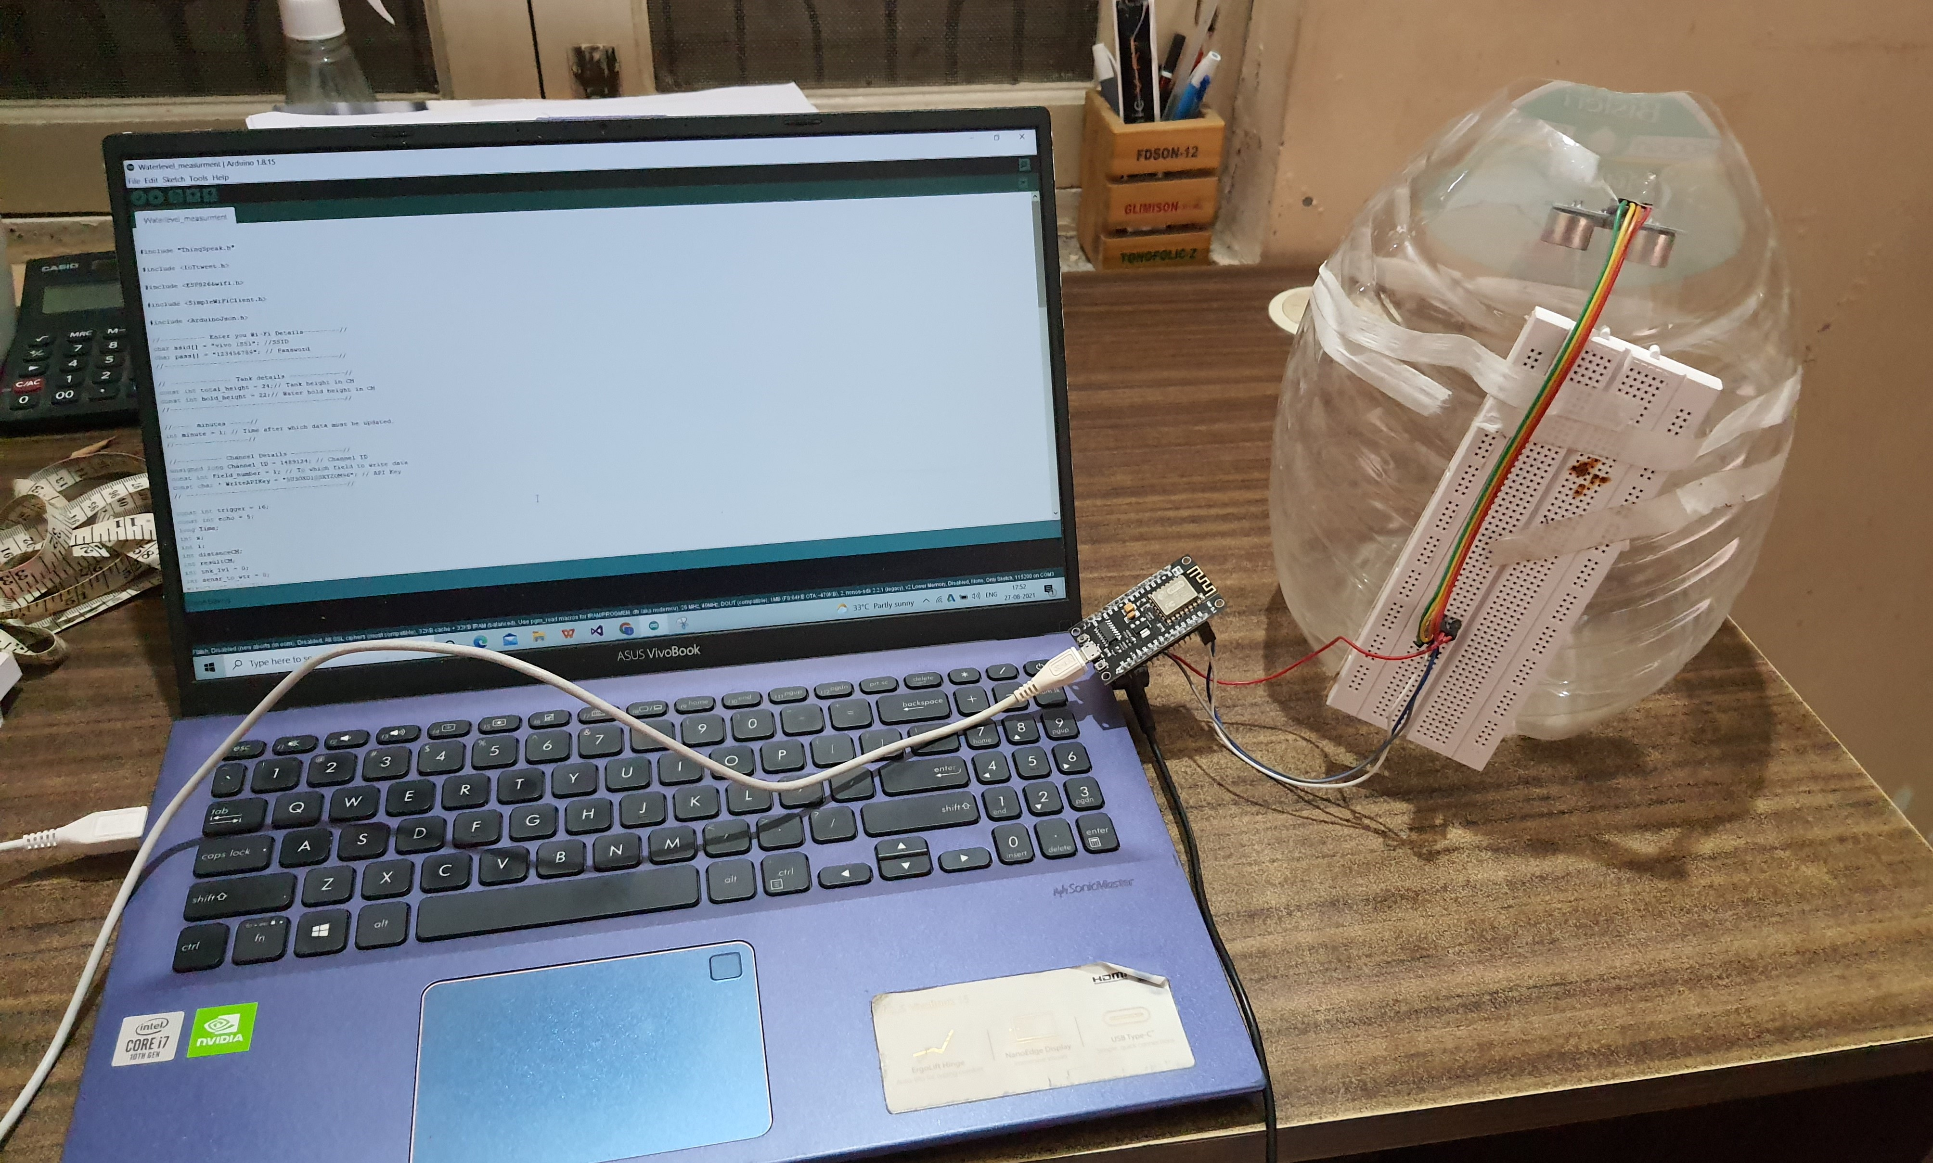
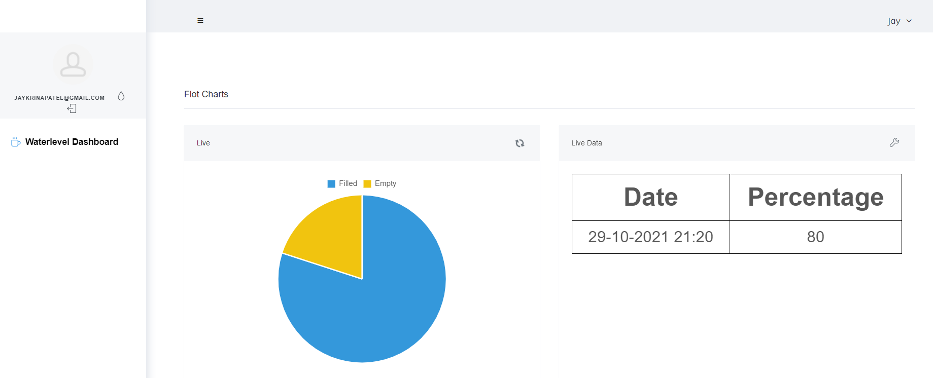
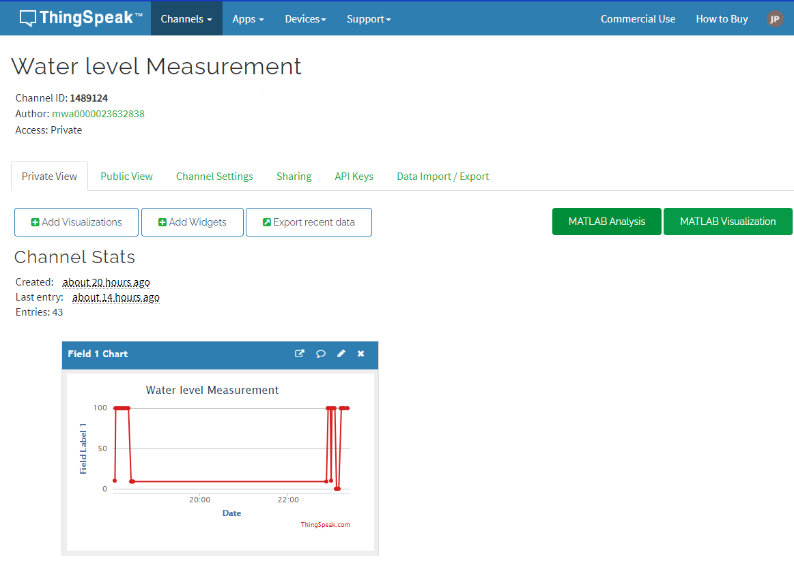
Sneak Peaks

Slide 8
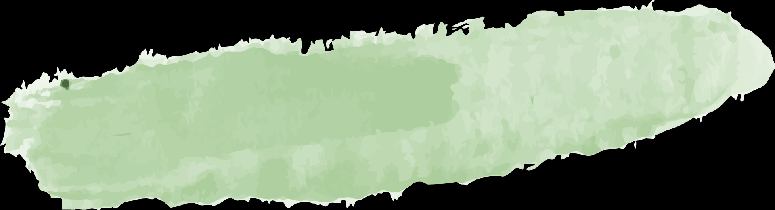



Learning Outcome
01
Knowledge
Got to know about new languages like ASP.net and C#.
02
Cloud computing
Learn to deal with cloud for storing data.
03
Data transfer
Learn transfer of data through cloud to application.
04
Multi-user platform
Used by multiple people at a time.

Slide 9
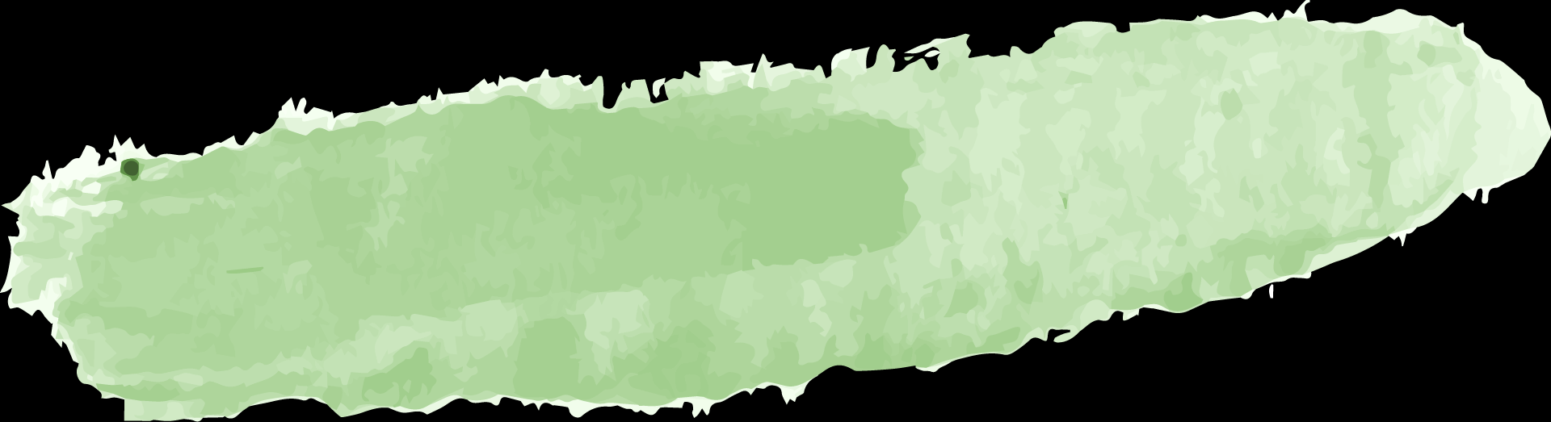
Limited Data
Tedious
Limitations
Height of tank
Network Connection
Only certain amount of data can be recieved by cloud 800 entries a day.
The height of the tank changed at each house so the measurment was to be done in such a way.
Sensor can give data for upto 400cm-500cm as per the capability.
Network should be provided to NodeMCU to sent data to website.

Slide 10


Future Scope
1.
2.
3.
4.
Can get data faster.
To get more amount of data.
Can get data of larger tanks. Size greater than 400cm.
Include some features in website.

Slide 11
References
•https://www.youtube.com/watch?v=sPfJ9f1FuUE
•https://electronics-project-hub.com/iot-based-water-level-monitoring-system/
•https://stackoverflow.com/questions/6695600/convert-datetime-to-valid- javascript-date/6697332\
•https://stackoverflow.com/questions/5687600/jquery-call-ajax-every-10- seconds/5687625
•https://stackoverflow.com/questions/1310159/how-to-do-this-using- jquery-document-getelementbyidselectlist-value
•https://stackoverflow.com/questions/6695600/convert-datetime-to- valid-javascript-date/6697332\
•https://stackoverflow.com/questions/5687600/jquery-call-ajax- every-10-seconds/5687625

Slide 12
THANK YOU

